Slide 1
Sentiment Analysis of Twitter Data for predicting movement in stock price of Apple Inc
Presentation by: Muhammad Shaheer
Aqsa Fatima

Slide 2

Factors that manipulate the stock
Price of a stock does not only depend upon demand and supply.
It can also be affected by
Political
Economical
Market Manipulation
https://www.dreamstime.com/stock-illustration-vector-bull-bear-symbols-stock-market-trends-growing-falling-image81813108

Slide 3
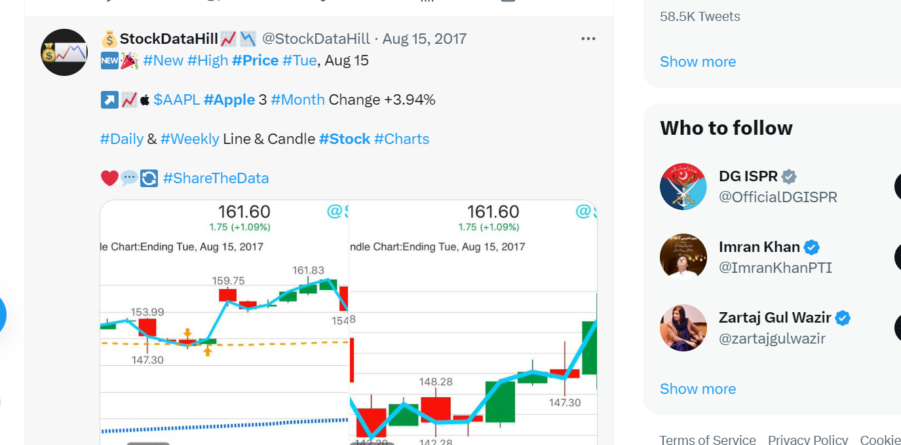
Why Twitter?
Because Twitter has almost 145million active users per day.
More credible and realizable than other social media platforms.
30 million of Twitter’s daily users are American.

Slide 4
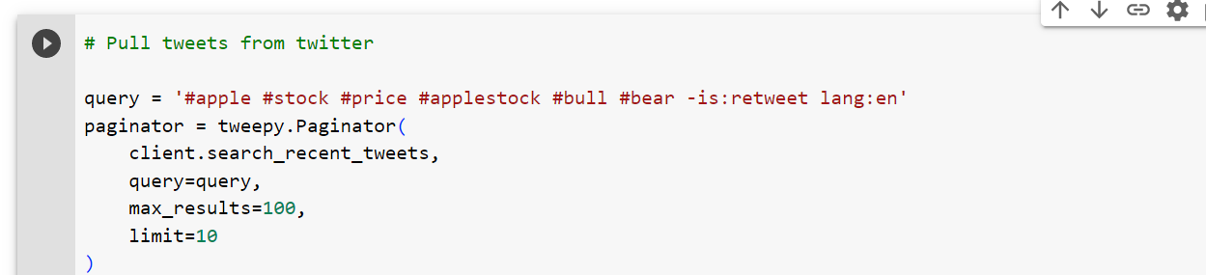
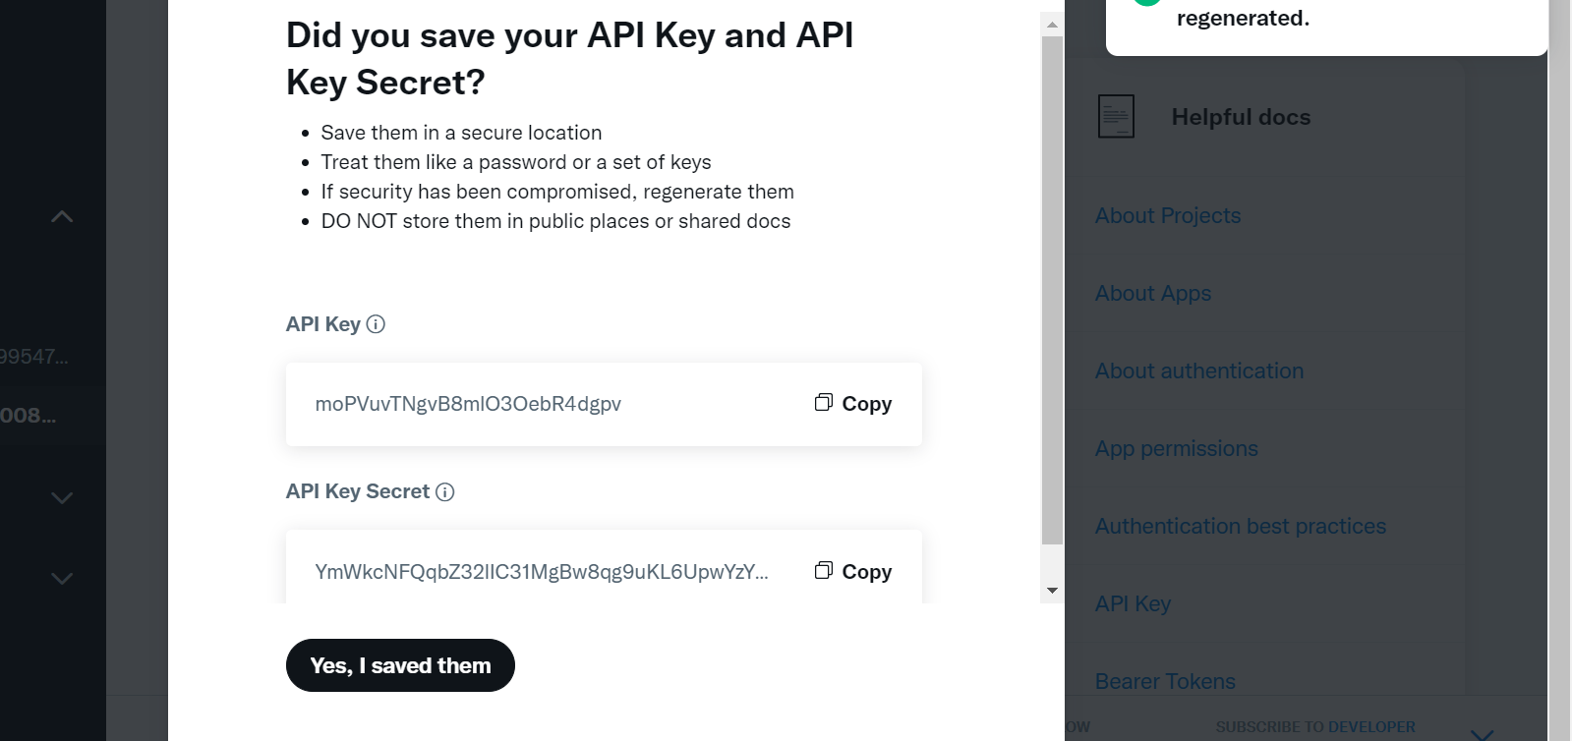
Tweeter API
Push or Pull Tweets from the Tweeter platform.
Has 3 different versions:
V1, v1.1, v2
All versions have different specifications
Every project has diff API, consumer and API, consumer secret keys

Slide 5
Text blob vs Vader
Text blob is used for NLP tasks
Tweet=“Buy the Apple Stock”
Tweet.sentiment
Will return 2 things polarity and subjectivity
Polarity is within the range of -1 to +1; either positive or negative
Subjectivity means either the text is factual or based emotions/personal opinion.
It is specifically used for social media sentiment analysis task
But less reliable than Text Blob
One good thing regarding Vader is that it tells how much the sentence is +ve, or –ve
Neg, neu, pos, and composite is the sum of all lexicon.

Slide 6
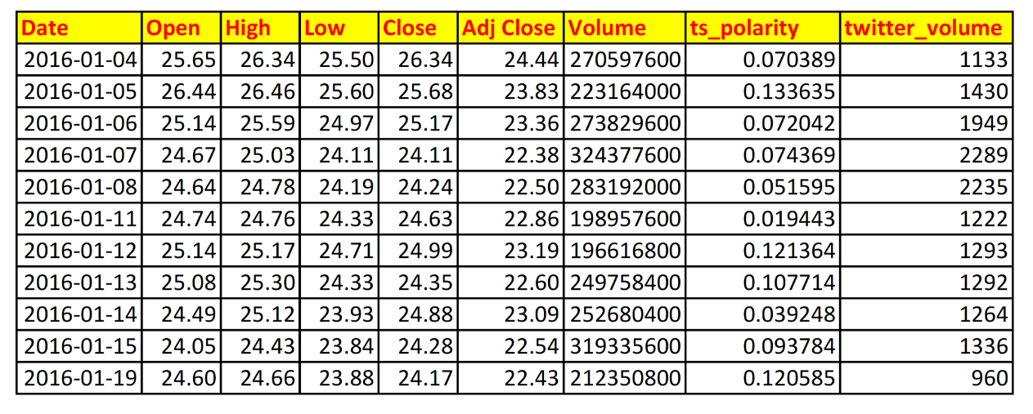
Merged the Polarity column with Yahoo data
Time duration is from Jan-01-2016 to Aug 31 2019
https://www.kaggle.com/datasets/nadun94/twitter-sentiments-aapl-stock

Slide 7
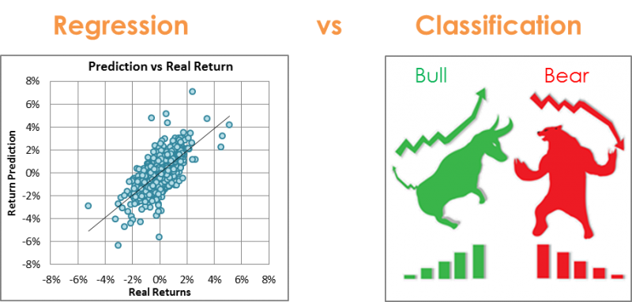
Predicting using 2 different approaches
Random Forest
https://quantdare.com/machine-learning-a-brief-breakdown/

Slide 8
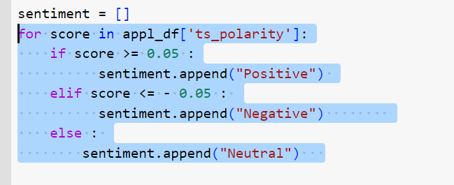
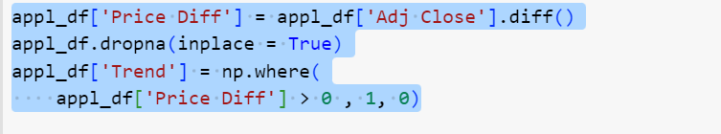
Classification
First we set the polarity
Set the trend, current-day-price
minus previous-day-price

Slide 9
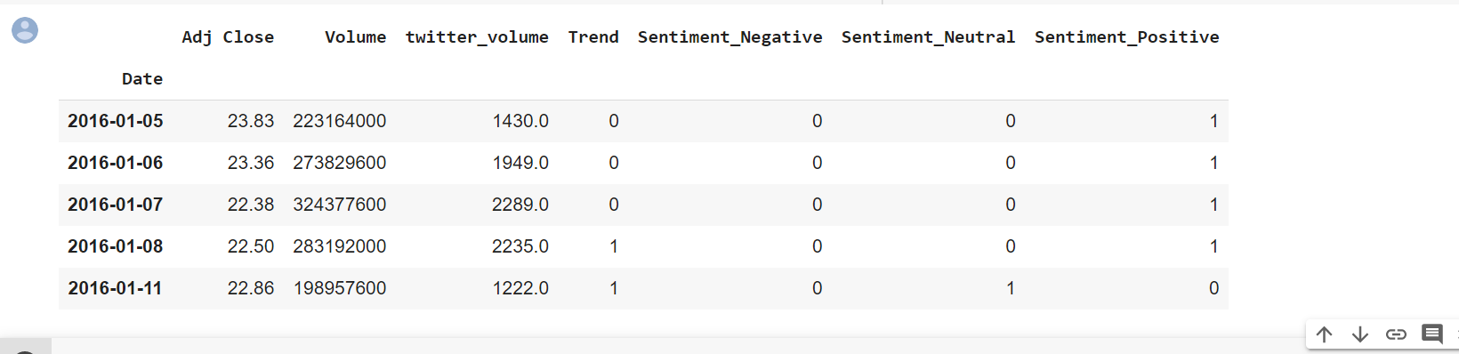
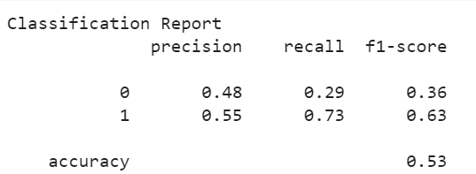
Poor performance on Classification
When the sentiment is +ve the trend is still –ve.
But when the sentiment is –ve the trend is +ve.
Accuracy Score : 0.5306859205776173

Slide 10
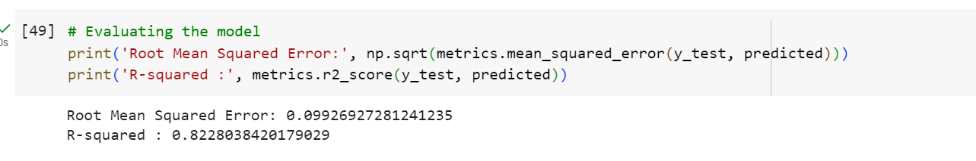
Regression
Set the polarity.
MinMaxscale: to avoid the outliers.
Model Evaluation: root mean squared error, R square error

Slide 11
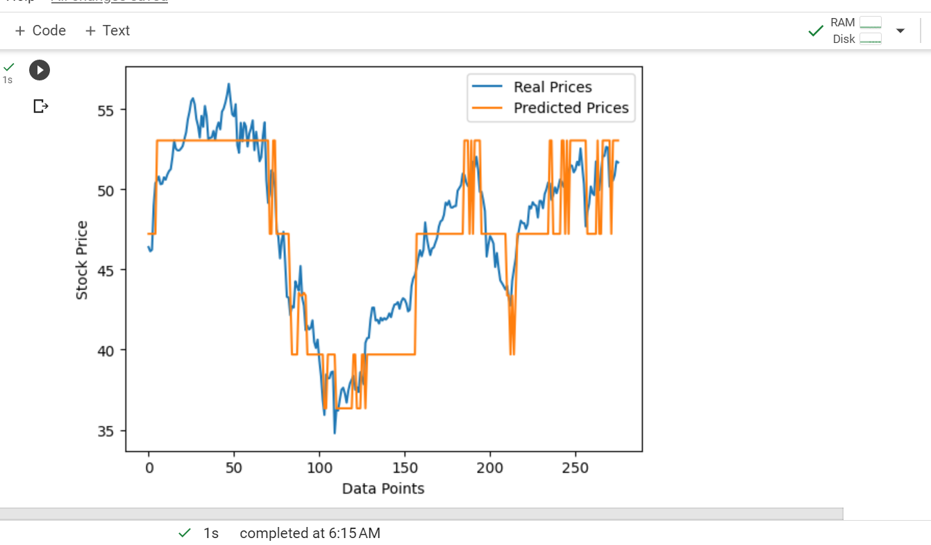
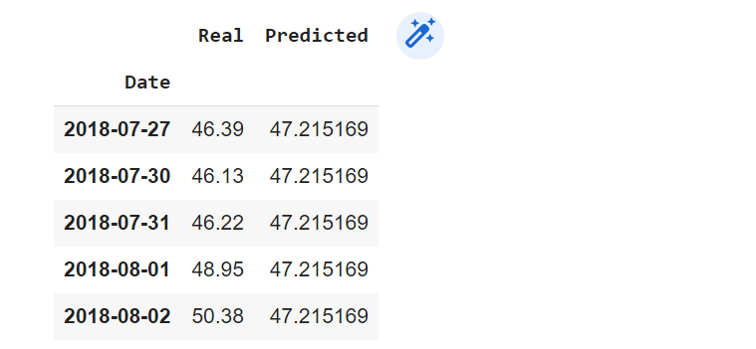
Regression

Slide 12
What can be done more?
Use multiple algorithms of regression rather than just RF.
Improved the dataset.
Use paid version of Twitter API to get latest data, and perform data cleaning.

Slide 13
Comparison with GatedRnn complemented by Cnn (autoencoded) approach
The proposed method use existing word list where each word is linked to a particular emotion.
Tweets were collected from Twitter, related to Indian Financial Market.
Inconsistencies were removed.
WordNet lexical dictionary was used to determine the polarity of each word.
Keyword based filtering was used as well – same as in the previous project.
Paper: Information Processing and Management A Bidirectional CNN-LSTM Based Dynamic Prediction of Stock Prices in Indian Market

Slide 14
Doc2vec
CNN can not interpret the sentences that is why each document was
Converted into a vector that cnn can comprehend.
Doc2vector compare the vector with the other vectors in the n-dimension space. The words/strings have same meaning will be found next to each other.

Slide 15
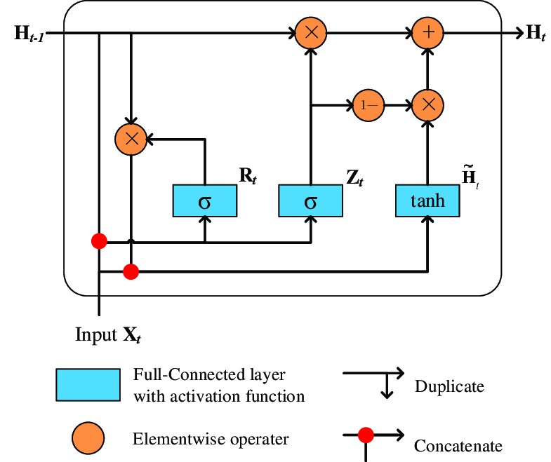
Gated-RNN
Traditional RNN has short term memory 2-3 words.
Lstm has long term memory plus short term as well.
Light weight LSTM is GRU.
There are 2 types of gates in GRU: ut, rt.
The ut/update gate determines how much historical information is added.
The rt/reset gate determines how much historical information is retained.

Slide 16
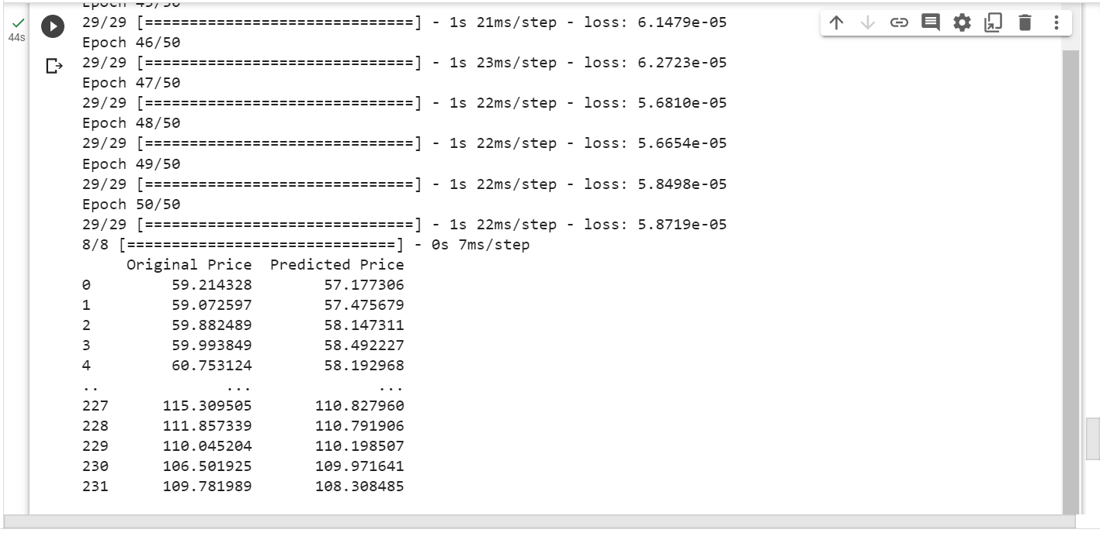
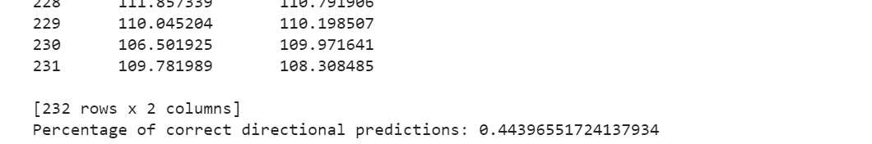

Slide 17
Thank you !

